Slide 1
2021

Slide 2
About us
Established
in
1999
7,5%
annually
Annual sales growth
Employees
More than
2000
12,5
thousand
Product range
Production facilities
53
thousand
m³
72
thousand
m³
Warehouses’ area
Products manufactured at Russian factories, per year
218
mln
More than
50%
Of profit margin we
Invest to development
IEK GROUP — is one of the leading Russian suppliers and manufacturers of lighting and electrical equipment under the brand name IEK® and LEDEL®, industrial automation equipment ONI® and product for IT technologies ITK®.
From 2020 - owner of the platform for building and manufacturing automation MasterSCADA.

Slide 3
Mission and values
In close cooperation with our partners we create reliable and available solutions for electric energy transmission, distribution and conversion, providing comfortable and safe environment for people’s lives and activities.

Slide 4
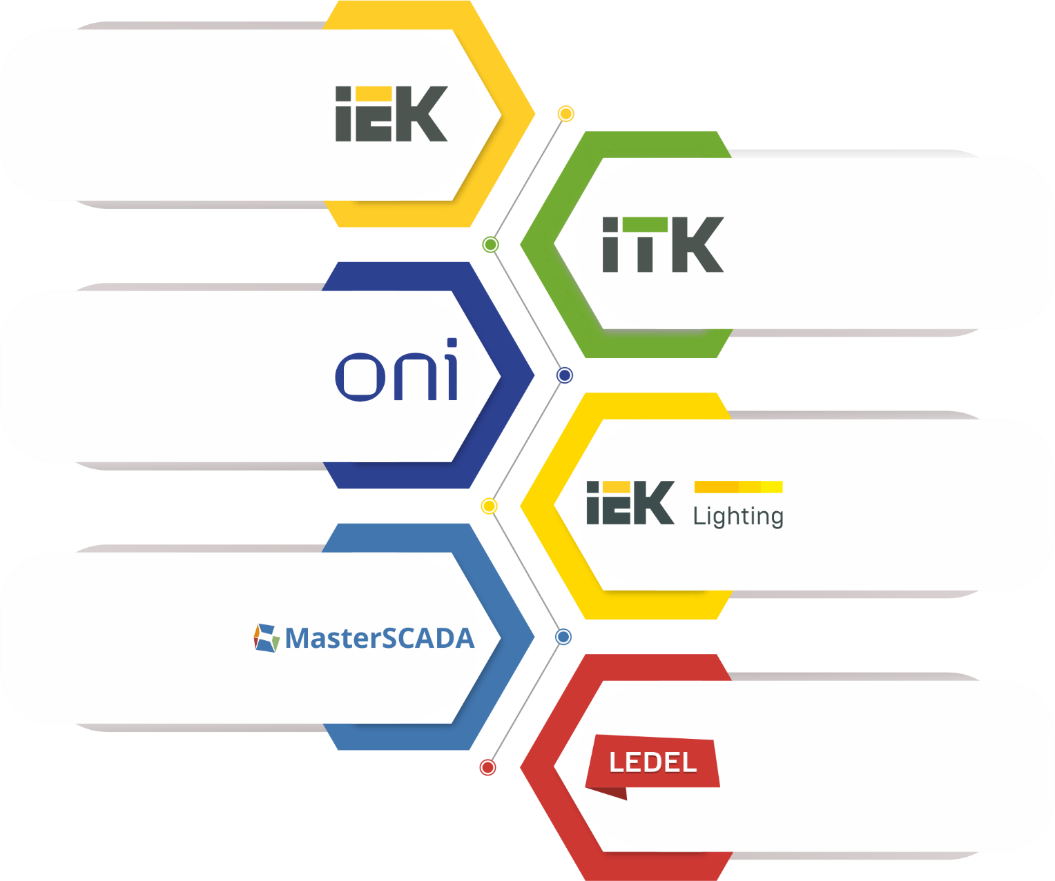
Our Brands
IEK® is the leader of electrotechnical and lighting markets for over 20 years.
№1 Electrotechnical Brand in Russia in 2014, 2016 and 2019
ITK® is a modern and reliable equipment for effective telecommunication solutions.
ONI® has a wide range of equipment and software automation of various industries.
IEK Lighting ® – a wide range of light sources, lamps, lighting control systems.
MasterSCADA ® — software solutions for the development of control and dispatching systems
LEDEL® is a professional lighting manufacturer of the project lighting for industrial, commercial, outdoor and office luminaries.

Slide 5
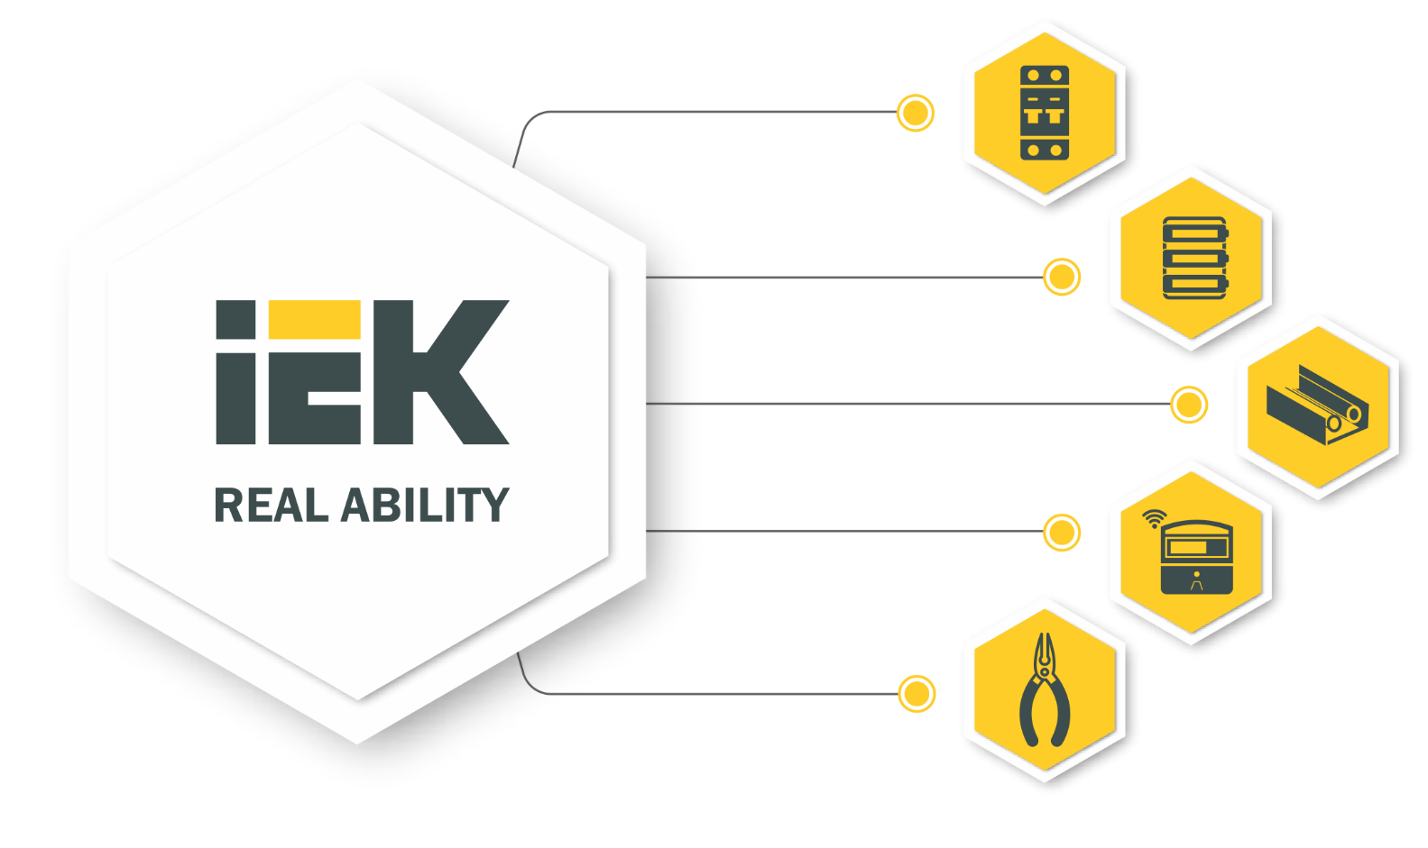
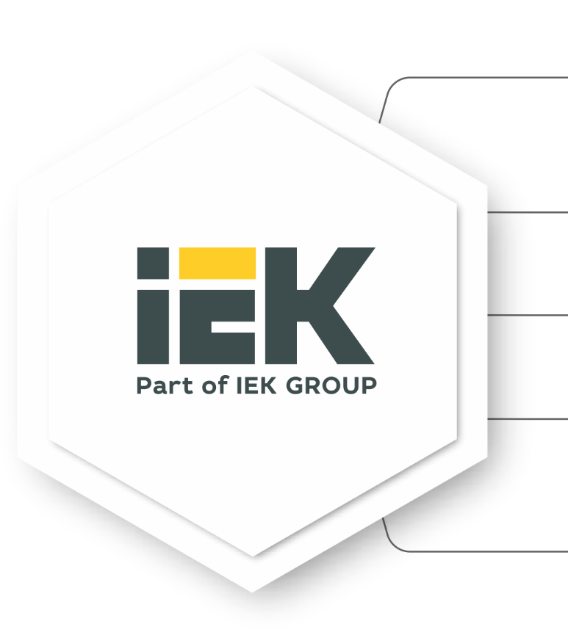
Electrotechnical equipment
Electric energy distribution equipment
Cabinets, boxes and accessories
Cable-carrying systems
Measuring and control equipment
Electrical wiring products, tools
www.iekgroup.com

Slide 6
IT equipment
Wiring cabinets
Power supply equipment
LAN-cable
Copper and optical components for structured cabling systems
Software databases of equipment for projecting programs
www.itk-group.ru

Slide 7
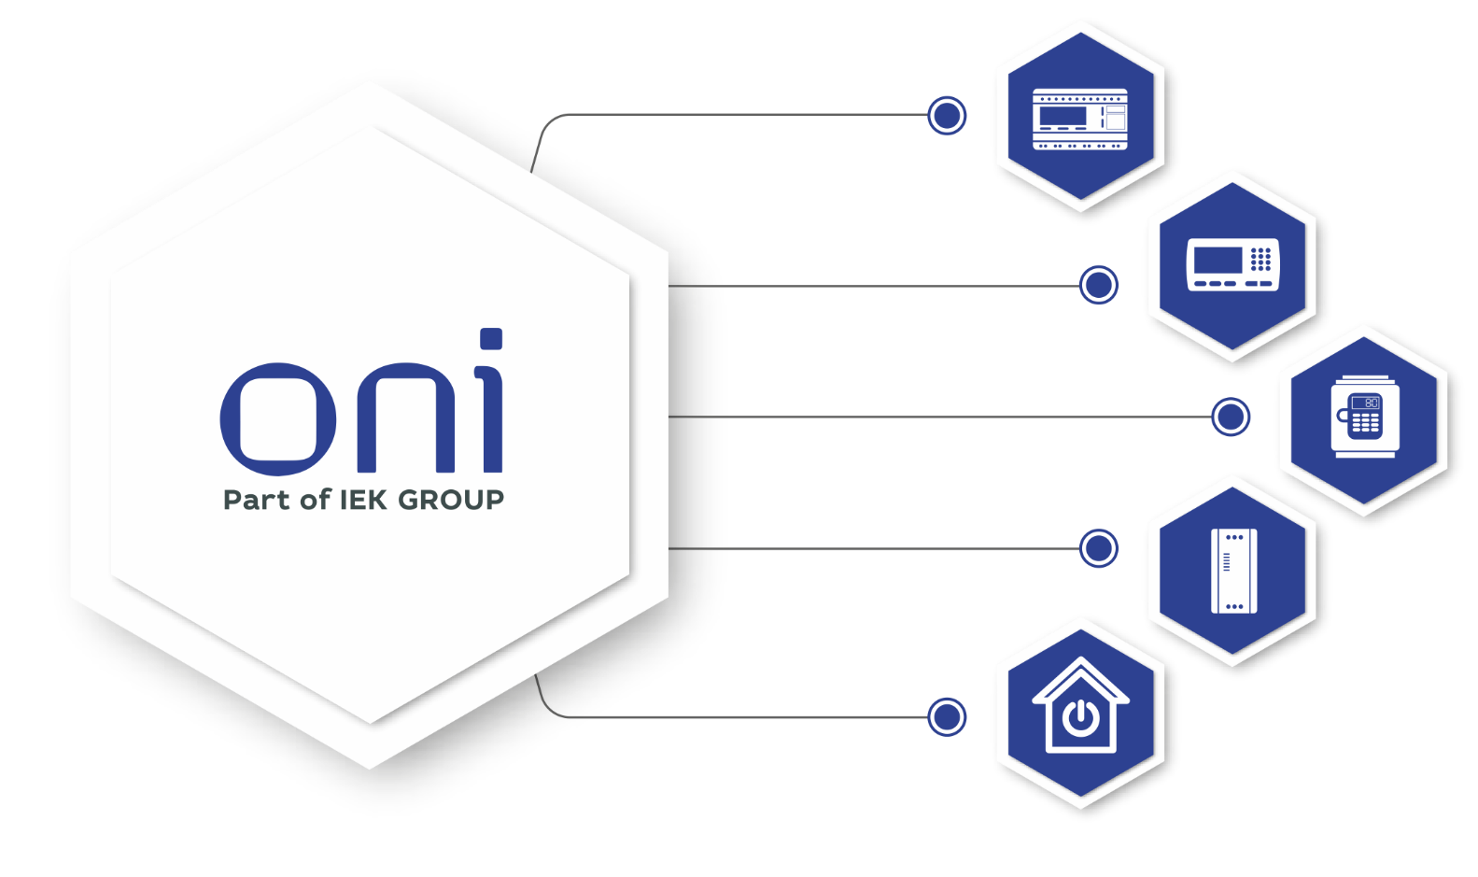
Industrial automation equipment
Programmed controllers
Controllers’ panels
Frequency converters
Softstarters
Smart Home
Manufacturing in modern factories
Multi-stage quality control
www.oni-system.com

Slide 8
Platform for building and manufacturing automation
Process visualization
Extensive communication capabilities
Visual analytics
Powerful report editor
Managing events and alarms
www.masterscada.ru

Slide 9
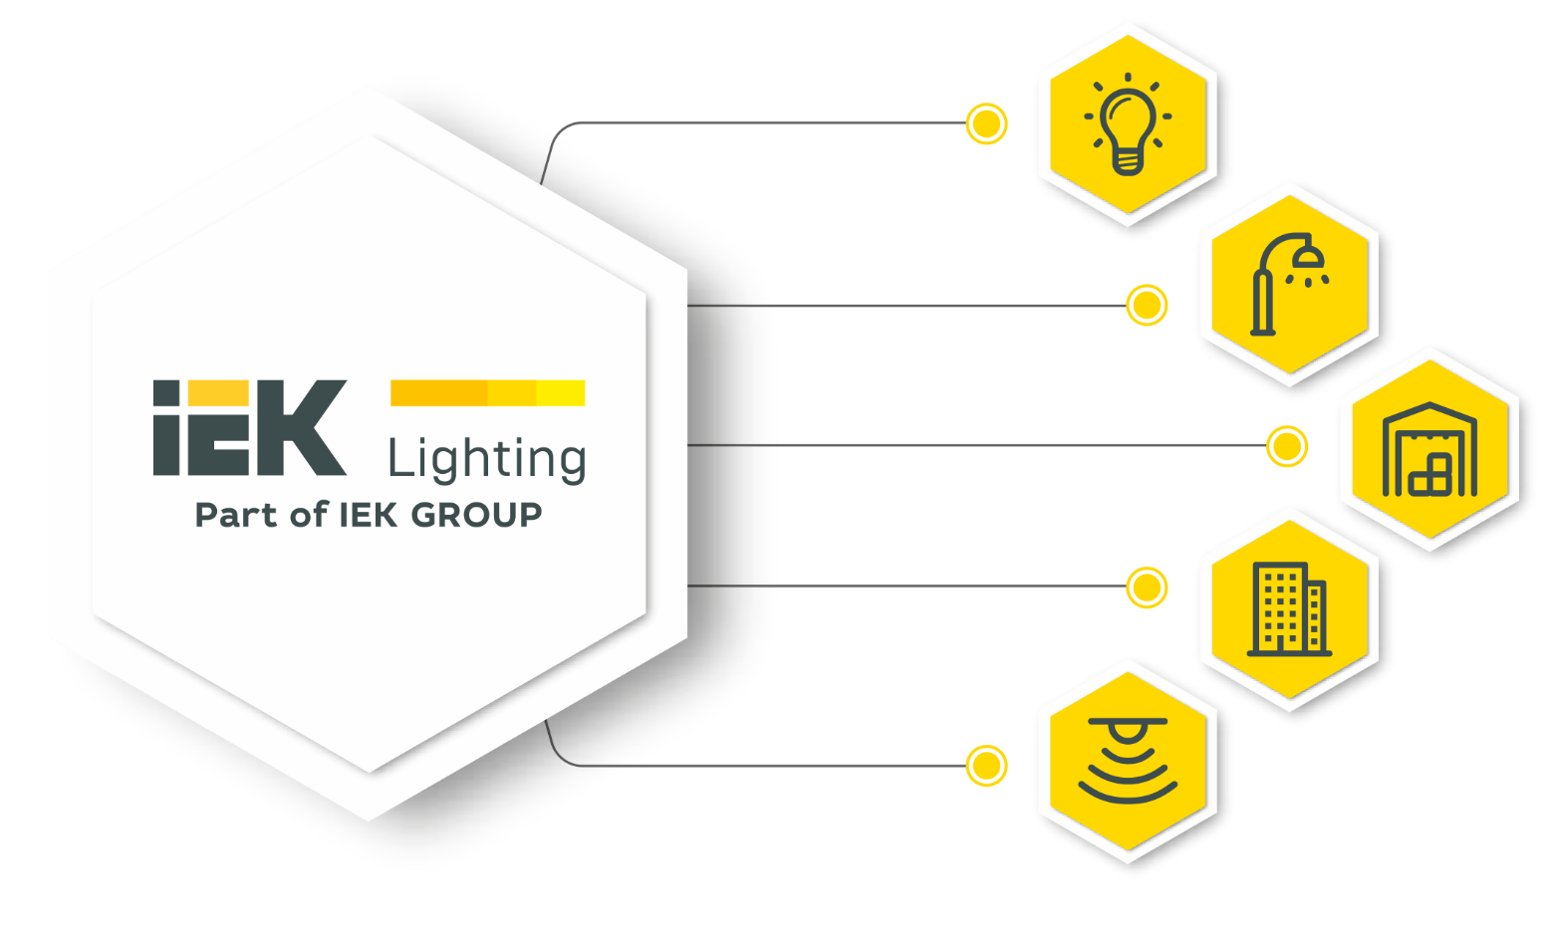
Lighting equipment
Bulbs
Street and architectural lighting
Commercial and industrial lighting
Utility and household lighting
Lighting control
Solutions for a variety of applications
Optimal price-quality ratio
www.iek.lighting

Slide 10
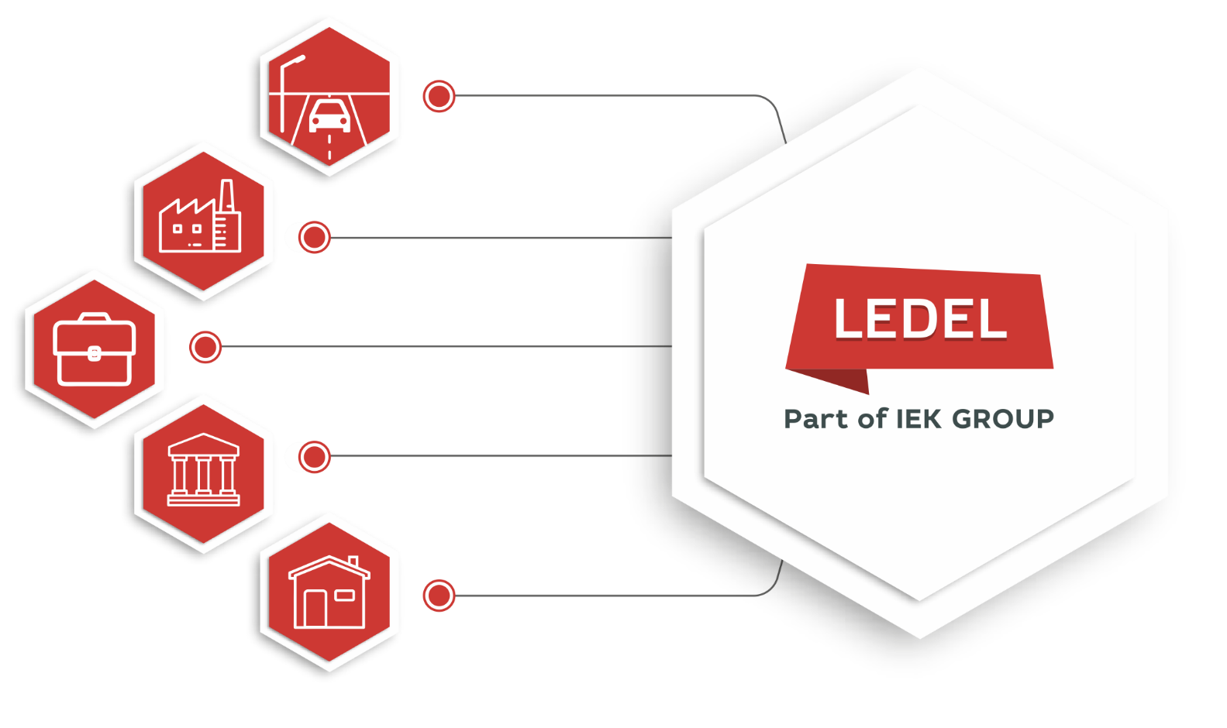
Professional technical lighting
Street and outdoor lighting
Industrial lighting
Commercial lighting
Architectural lighting
Office and household lighting
Design and production of innovative products in Russia
www.ledel.ru

Slide 11
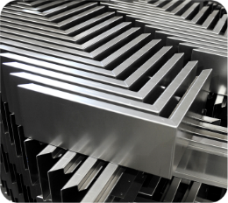
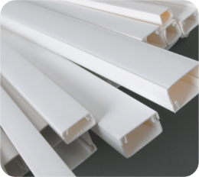
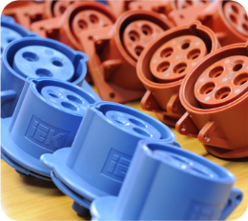
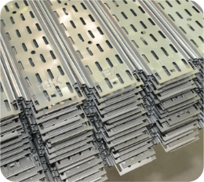
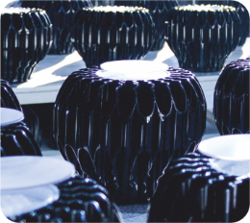
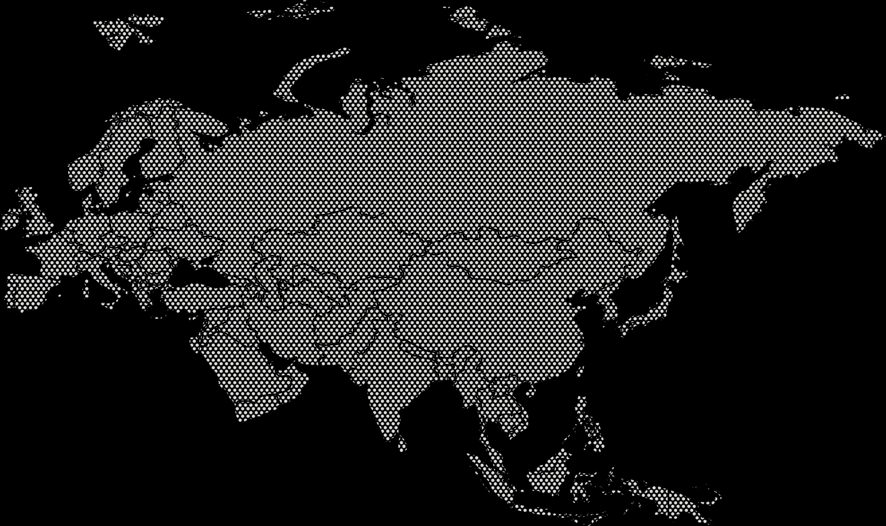
Made in Russia
Metalwork
Extrusion
Cast production
Rolled metal products
Lighting
Moscow
Riga
Yasnogorsk
Kazan
Kiev
Novosibirsk
Chisinau
Almaty
Vladivostok
Ulaanbaatar
Tbilisi
Tashkent
Ningbo
IEK GROUP manufacturing facilities
IEK GROUP warehouses
Software development

Slide 12
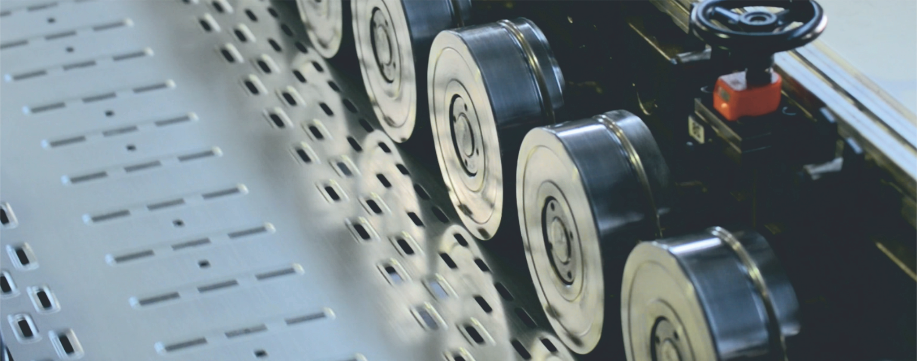
100% owned production in Russia
Large-scale
modernization
Growth
of facilities
Automated lines
Annually production volume
1,9 Million
of metal boxes
5 Million
plastic boxes
25 Million
meters of metal cable trays
209 Million
meters of plastic cable carrying systems
620 thousand
of luminaries
15 million USD
Annual investments in the development of production facilities

Slide 13
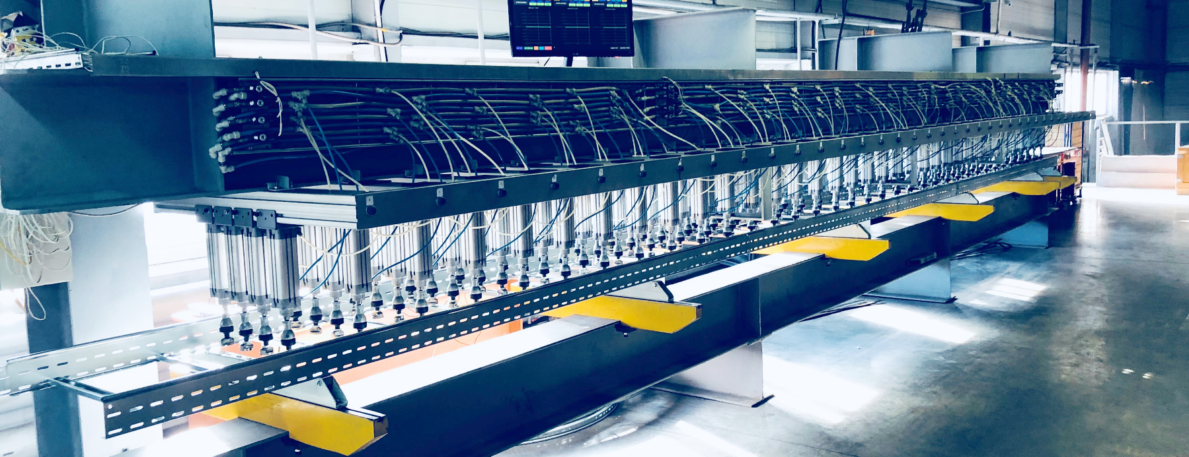
R&D
Own design engineering bureau, equipped laboratories
Patents and Certificates

Slide 14
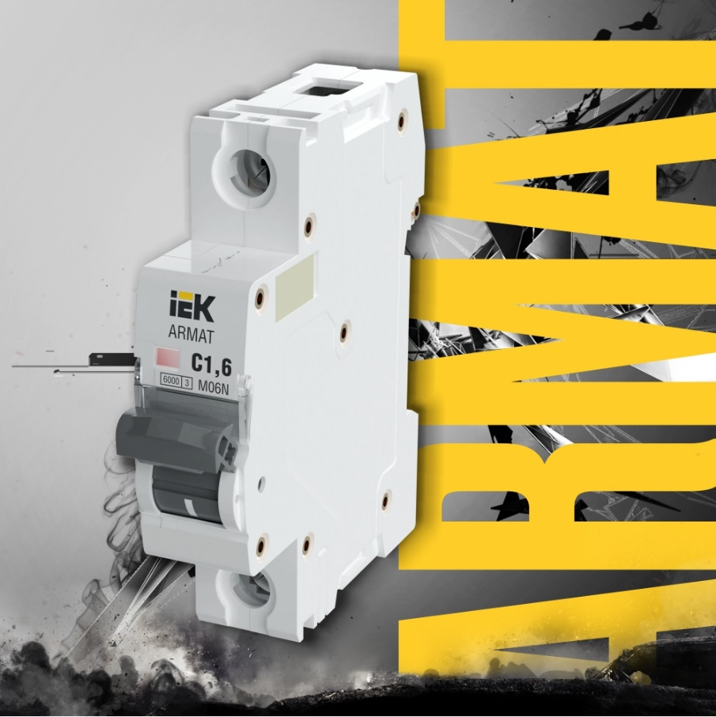
Key Projects
ARMAT
IEK® Modular equipment
High tripping speed
Increased switching and electrical durability
Increased case thickness
Enhanced arc splitter
Universal for AC and DC solutions
Confirm to IEC 60947-2 and IEC 60898-1
Notes:
Широкий ассортимент, в т. ч. дополнительных устройств.
Устройства на постоянный ток.
ПКС до 10 кА в т. ч. на промышленный стандарт.
Увеличенная прочность и износостойкость.
Основные сегменты для линейки ARMAT:
Промышленность (защита ответственных производственных линий).
Жилищное строительство комфорт- и бизнес-класса.
Коммерческое строительство (защита и распределение на уровне ГРЩ и систем автоматизации).

Slide 15
Key Projects
FORMAT
IEK® electrical cabinets up to 6300 A
Dismountable construction on a fully symmetrical profile
Up to 4b separation class
European certificates
Notes:
Симметричность конструкции.
Максимальное использование пространства корпуса.
Удобство монтажа.
Жесткость конструкции – несущая способность 1,6 тонны.
Долговечность - применим в тяжелых условиях эксплуатации.
Безопасность - отсутствие вихревых токов в корпусе шкафа.

Slide 16
Key Projects
LESTA
IEK® Metal ladder trays
Unique design - increased hardness, increased bearing capacity
Optimal set of accessories
Reinforced telescopic connection
Bonding technology - clinching
Notes:
Высокие показатели БРН.
Запатентованное техническое решение.
Лотки длиной 6 метров.
Расположение перекладин в шахматном порядке для удобства крепления кабеля и аксессуаров.
Сложный профиль лонжерона для обеспечения прочности лотка за счет увеличенного количества ребер жесткости.

Slide 17
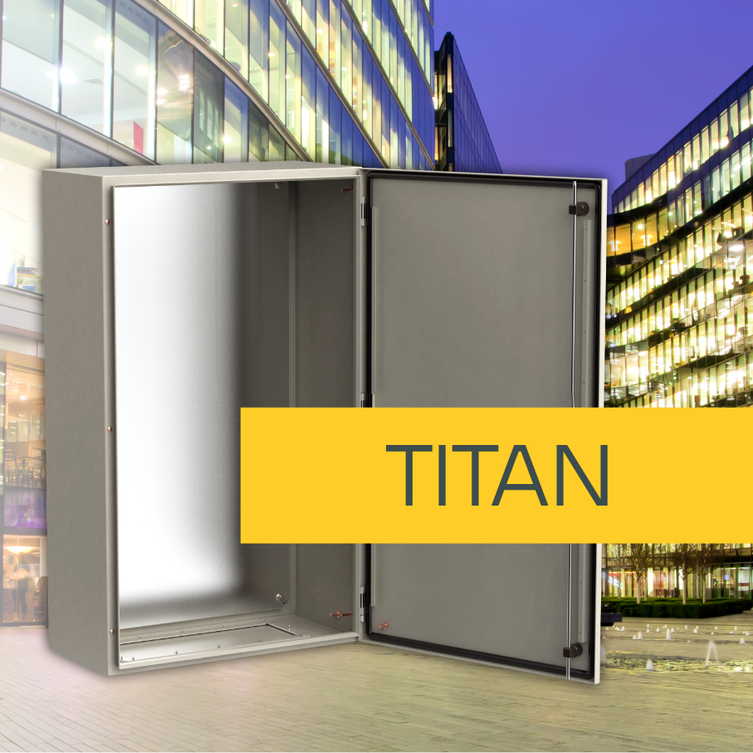
Key Projects
TITAN 5
IEK® Metal cabinets
New construction with removable mounting frame - convenience and ease of assembly
A set of necessary accessories - busbars and non-flammable support included
Wide range of sizes - up to 216 modules
Notes:
Широкий ассортиментный ряд - 110 SKU. Габариты от 250 до 1400 мм с шагом в 50 мм.
Средний ценовой сегмент (TITAN 5 IP55).
Широкий выбор аксессуаров.
Улучшенная упаковка всех корпусов. Пятислойный картон.
Перенавешиваемая дверь на всех габаритах и сериях.
Стабильно высокое качество изготовления. Полностью автоматизированная линия: от рулона стали до готового изделия.
Высочайшее качество покраски и стойкости к внешним агрессивным воздействиям. Подтверждено испытаниями в камере соляного тумана.
Уличное исполнение УХЛ1 (от -50 до +50 °С ).

Slide 18
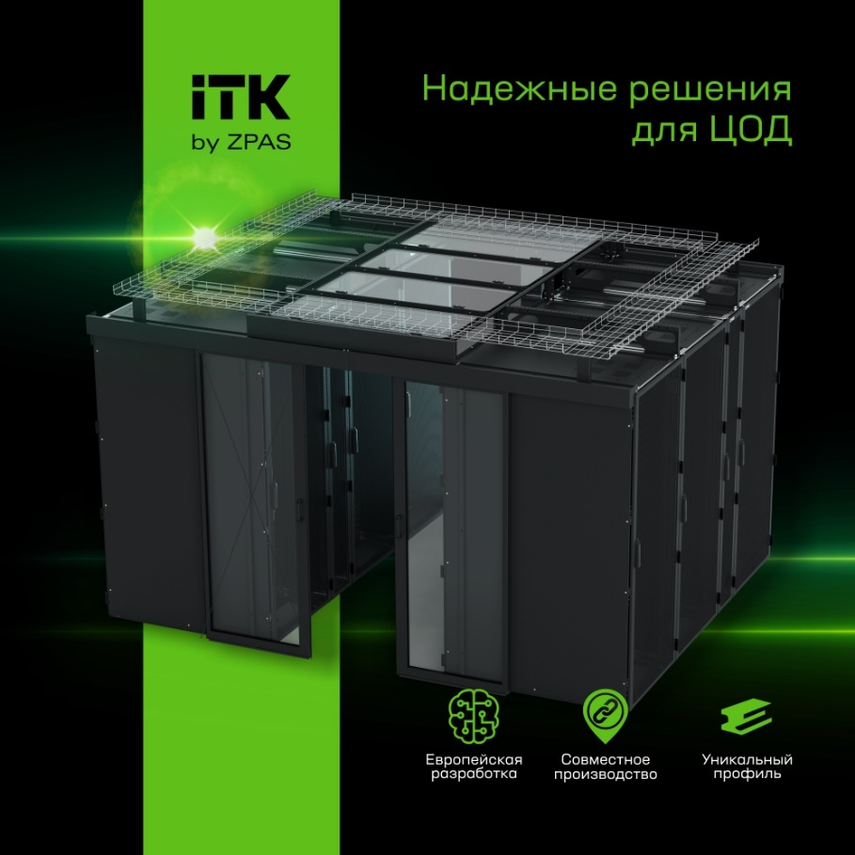
Key Projects
ITK® by ZPAS
Complex solutions for data centers
Server cabinets ITK® by ZPAS
Accessories
Optic wire tray system
Air conditioning systems for data centers
Monitoring systems
Notes:
Серверные шкафы ITK® by ZPAS
Европейская разработка.
Статическая нагрузка 1500 кг.
Широкий ассортимент исполнений и габаритов.
Быстрая сборка.
Уникальный высокопрочный профиль.

Slide 19
Key Projects
Twisted copper pair wire ITK®
Made in Russia
Fire-resistant cable for fire protection systems. European development
Industrial RS-485 cable smart energy meters
Fire-resistant RS-485 cable, halogen-free for industrial enterprises, armored
Notes:
Кабель для систем противопожарной защиты
Огнестойкость – 180 мин.
Сертификация ОКЛ в составе кабельной линии.
Пожаробезопасные исполнения - безгалогенные, с низким дымо- и газовыделением.
Срок службы – 30 лет.
Кабель для промышленного интерфейса RS-485 для АСКУЭ
Стабильные электрические параметры на всей длине линии.
Пожаробезопасные исполнения – безгалогенные, с низким дымо- и газовыделением.
Кабель огнестойкий, безгалогенный для промышленных предприятий
Броня голая и в защитном шланге.
Поддержка интерфейса RS-485.
Монтаж без использования металлорукава или трубы.

Slide 20
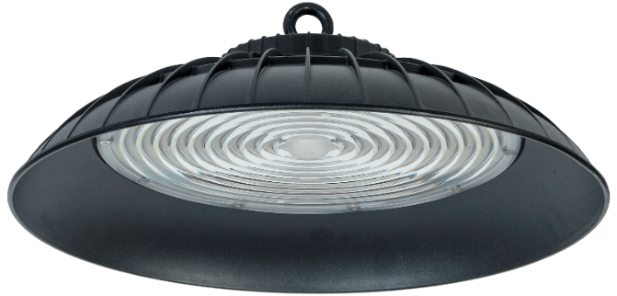
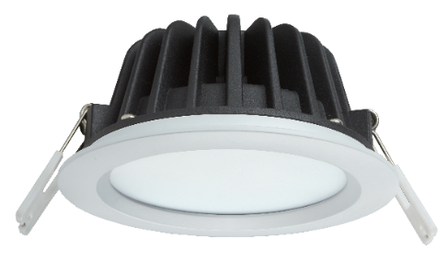
Key Projects
Professional lighting equipment
Improved technical characteristics
Light control systems

Slide 21
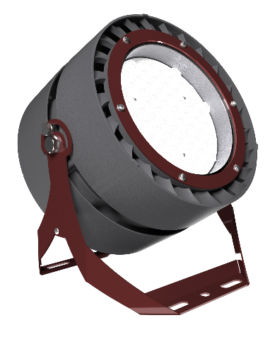
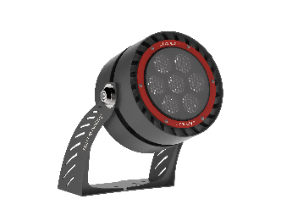
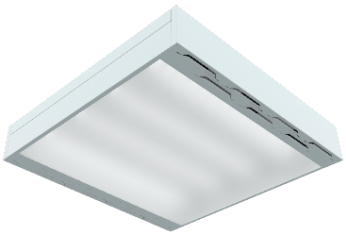
Key Projects
Facade, linear, window lighting
LEDEL® first architectural line
Floodlighting
Unique efficiency of 190 lm/W
Dual cooling system
Office lighting
First office light patent
Solutions for general and design lighting
Control systems

Slide 22
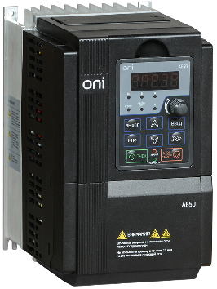
Key Projects
Complex solutions for engineering systems
Vertically integrated control system development platform
Automatic load transfer
Sewage pumping station automation system
Notes:
MasterSCADA:
Российский разработчик.
Разработка тиражируемых решений.
Кросс-платформенность.
Драйверный интерфейс коммуникационных протоколов.
Резервирование каналов связи, серверов и клиентских рабочих мест.

Slide 23
Quality standards
Client-oriented focus
Customers and partners’ satisfaction
Stability in quality of products
Obligatory and voluntary certification
Business System
Quality management
Quality mark
Constant perfection and development
Compliance with ISO 9001-2015 requirements

Slide 24
IEK GROUP Academy
Courses and tests
Sales Training
Webinars
Education videos
Seminars, Trainings and master-classes
Open-access training digital platform for market professionals
25 000 digital courses are being studied by participants annually
6 000 webinars’ participants annually
www.iek-edu.com

Slide 25
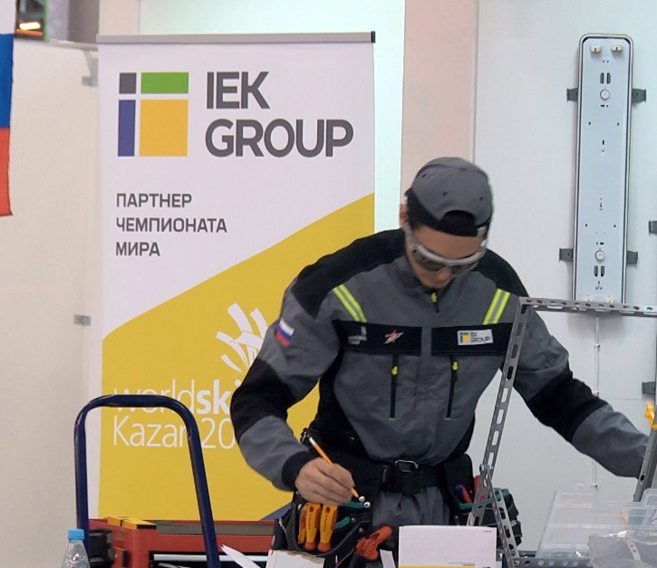
Participation in development of the field’s expertise
Field expert of the Worldskills international Electrical Installation standard
Worldskills Russia partner since 2013
Cofounder of «Electric Installation» competence in Russia
Participant of national carrier-guidance programs
Professional development programs for youth

Slide 26
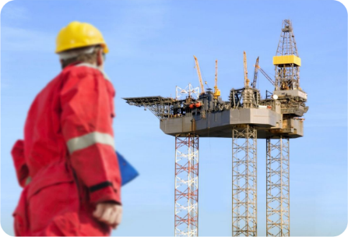
Solutions for various industries
For residential buildings
For telecommunications
For residential buildings
For oil and gas industry
For agricultural sector
For road construction

Slide 27
Our partners

Slide 28
IEK GROUP of companies
Headquarters of IEK GROUP, RUSSIA
Address:108803 Moscow Varshavskoye Shosse 28-th km. building 3
Tel./fax: +7 495 542 22 22
Email: sales@iekgroup.com
Meanwhile the wide range of representative offices include:
UKRAINE
Address: ul. Kievskaya , 6 V, Vishnyovoe, 08132, UKRAINE
Phone: +38 (044) 536-99-00
Email: info@iek.com.ua
Website: www.iek.ua
BELARUS
Address: REPUBLIC of BELARUS, 220025, Minsk, Shafarnyanskaya str., 11 apt. 62, office 204;
Phone: +375(17) 268-36-29; +375(44) 555-8-550
Email: iek.by@iek.ru
MOLDOVA
Address: 21 Maria Dragan str., Chisinau, MD-2044, the Republic of Moldova
Telephone: +373 (22) 479-065, +373 (22) 479-066
Fax: +373 (22) 479-067
E-mail: info@iek.md; infomd@md.iek.ru
Web-site: www.iek.md
SIA IEK Northern Europe
Address: Maskavas iela 497, Rumbula, Stopiņu pagasts, Ropažu novads, LV-2121, Latvija
Telephone:+371 67205159, +371 28684723
E-mail: infoneu@iek.group
Web-site:
KAZAKHSTAN
Address: KAZAKHSTAN, 040916 Almaty Region, Karasay District, Irgely village, Akzhol Micro-District 71А
Telephone: +7-727-237-92-50
E-mail: infokz@iek.ru
Web-site: www.iek.kz
MONGOLIA
Address: MONGOLIA, Ulan Bator, Plot 20 of Bayangol District, Western Zone of Industrial Area 16100, Moscow Street, 9
Telephone: +976 7015-28-28
Fax: +976 7016-28-28
E-mail: info@iek.mn
Web-site: www.iek.mn

Slide 29
IEK GROUP of companies
UZBEKISTAN
Address: REPUBLIC of Uzbekistan, 100074, Tashkent, Yashnabadsky district, Mukhtara Ashrafii str., 1-st drive. 9a bld.
Phone: +998 (71) 231-84-31, +998 (71) 231-84-32
Email: info@iek.uz
VIETNAM
IEK VIET NAM CORPORATION
Address: No. 139 Nguyen Thai Hoc Str., Dien Bien Ward, Ba Dinh Dist., Hanoi, Viet Nam, 100000
Phone: +84 24 2265 1818
Email: iekvietnam@gmail.com
INDIA
ANITECH
Address: Unit No:202, RG Trade Tower, Netaji Subhash Place, Pitampura, New Delhi-110034, India
Phone: +91 11-45700559
Email: info@anitech.co.in
GERMANY
EDELIZON Handelsgesellschaft mbH
Address: 50933 Köln, Eupener Sraße 124
Phone: +49 (0) 221 4230 6965
Fax: +49 (0) 221 4230 6966
E-mail: n.efimenko@edelizon.de
MALTA
Hydrolectric Ltd
Address: 85, Triq il-Kappillan Mifsud Hamrun HMR1855, Malta
Phone: +356 ¬2124 1111
Fax: +356 2124 3706
E-mail: info@hydrolectric.com.mt
POLAND
Sundex Group Sp. z o.o.
Address: 80-126, Gdansk, Stanislawa Lema, 4a/1
Phone: 58 585 99 99
E-mail: info@sundexgroup.com
BANGLADESH
Universal Engineering & Technology Co. Limited
Address: 66/13, West Rajabazar, Indira Road, Dhaka-1215, Bangladesh
Phone: + 880 1713 012210; +880 1713197300; +8801713197400
E-mail: parvez.zubair@utechbd.com
EGYPT
Afifi foundation for Transport
Address: 73 Amarat Al-Fath, apt. 2, Nasr City, Cairo, Egypt
Phone: +20 240 331 869
E-mail: afifi.foundation@hotmail.com

